Slide 1
Metabolic Reactions, Energy Transfer, The Fate of carbohydrate
Classification of Carbohydrate
Carbohydrate Metabolism:
Glycolysis
Acetyl Co-A formation
Krebs cycle
Electron Transport Chain Reactions

Slide 2
Classification of Carbohydrate
Carbohydrates are biological molecules made of carbon, hydrogen, and oxygen in a ratio of roughly one carbon atom [C] to one water molecule [H2​O],
This composition gives carbohydrates their name: they are made up of carbon (carbo-) plus water (-hydrate).
Carbohydrate chains come in different lengths, and biologically important carbohydrates belong to three categories:
Monosaccharide
Disaccharide and
Polysaccharide.

Slide 3
Monosaccharides
Monosaccharides have a formula of (CH₂O)_{n}
They typically contain three to seven carbon atoms
The position of the carbonyl (C=O) group can be used to categorize the sugars:

Slide 4
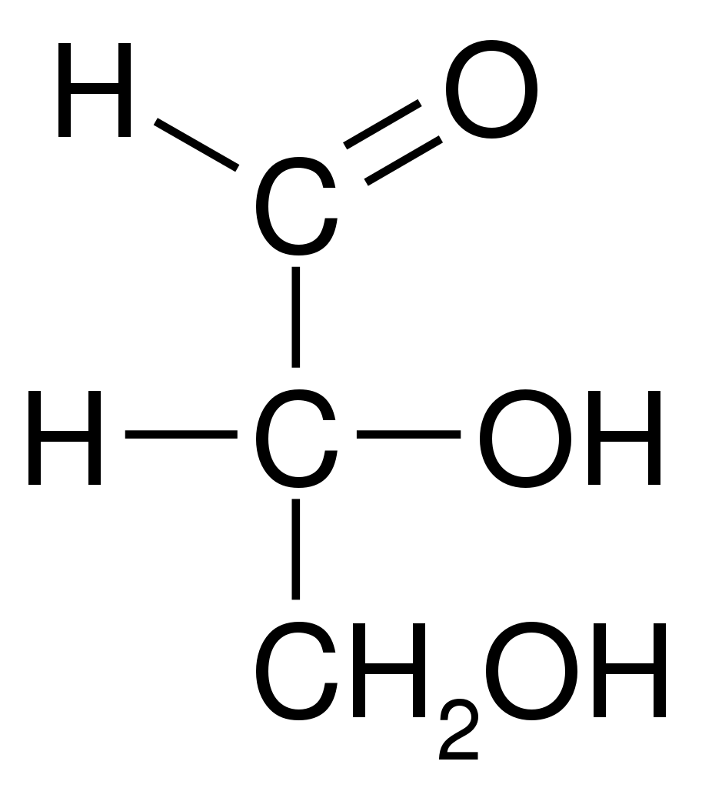
Monosaccharides
If the sugar has an aldehyde group, meaning that the carbonyl C is the last one in the chain, it is known as an aldose.

Slide 5

If the carbonyl C is internal to the chain, so that there are other carbons on both sides of it, it forms a ketone group and the sugar is called a ketose.

Slide 6
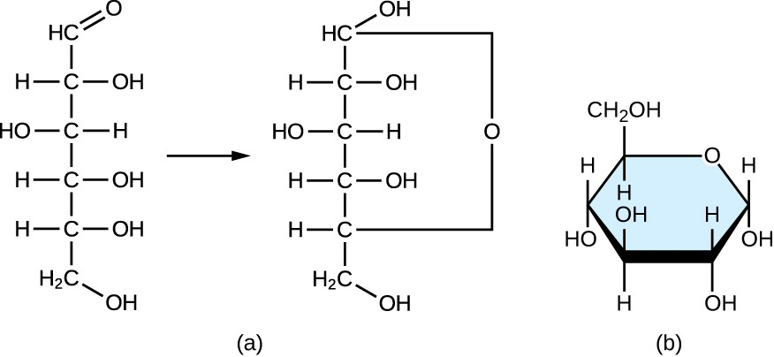
Monosaccharides

Slide 7
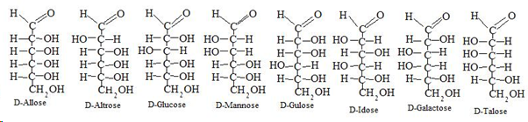
Isomers of Aldose

Slide 8
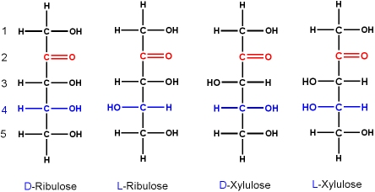
Isomers of Ketose

Slide 9
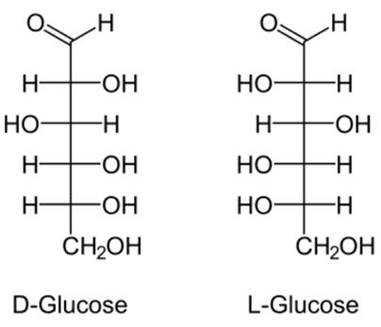
D and L dexter[right] and laevus[left]

Slide 10
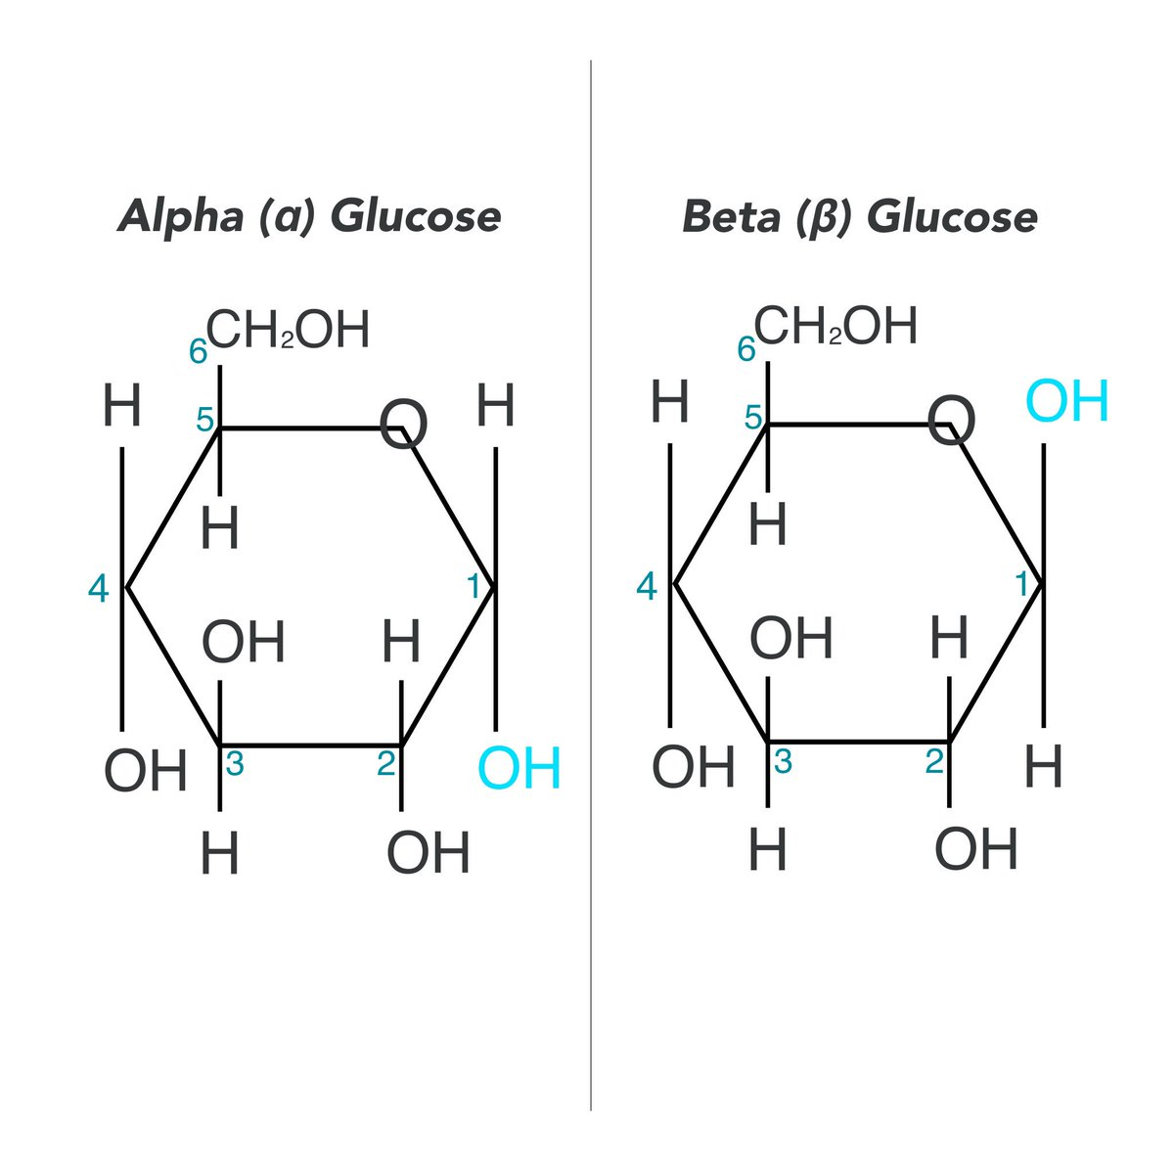
Alpha and Beta Glucose

Slide 11
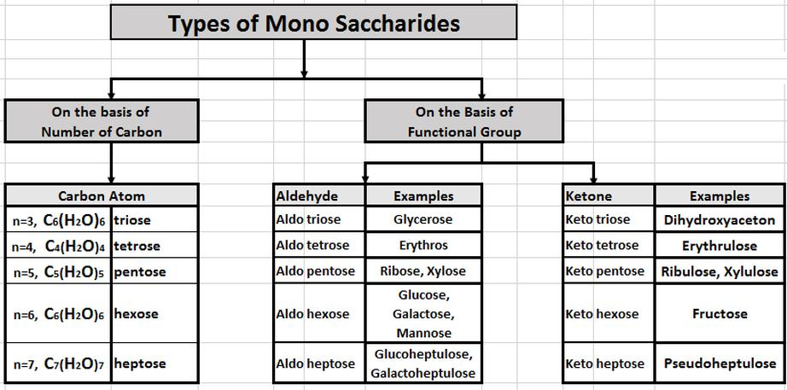
Types of Monosaccharide

Slide 12
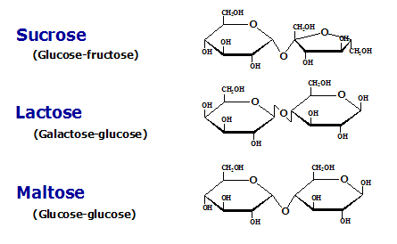
Disaccharides

Slide 13
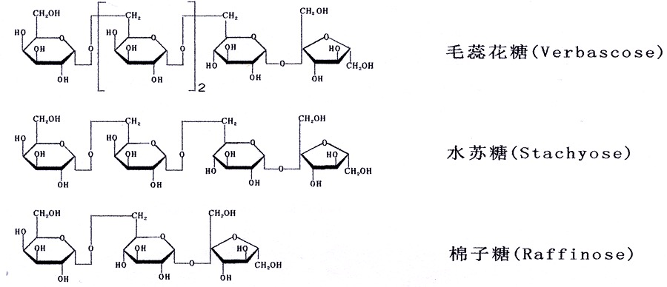
Oligosaccharides

Slide 14
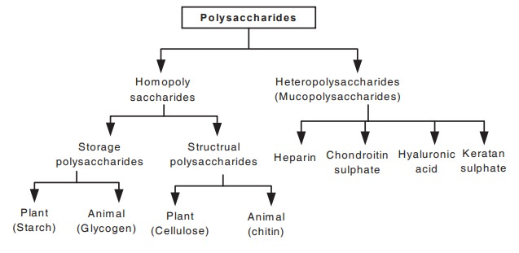
PolySaccharides

Slide 15
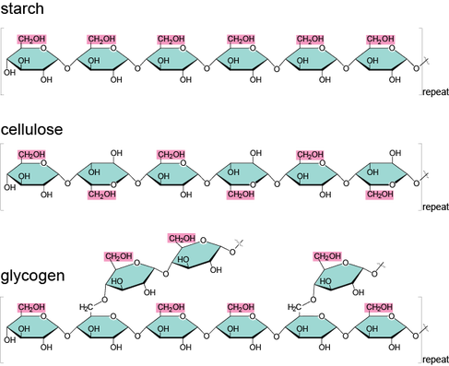
Types of Polysaccharides

Slide 16
Metabolism
Metabolic reactions contribute to homeostasis by harvesting chemical energy from consumed nutrients for use in the body’s growth, repair, and normal functioning.
Catabolism
Anabolism

Slide 17
Catabolism
Those chemical reactions that break down complex organic molecules into simpler ones are collectively known as catabolism

Slide 18
Anabolism
Chemical reactions that combine simple molecules and monomers to form the body’s complex structural and functional components are collectively known as anabolism

Slide 19
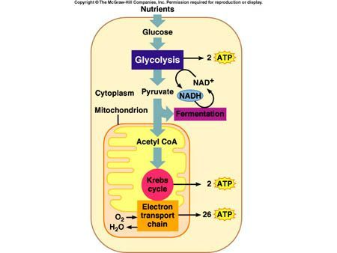
Glycolysis

Slide 20
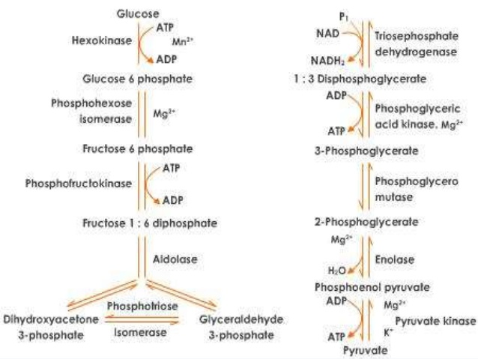
Glycolysis

Slide 21
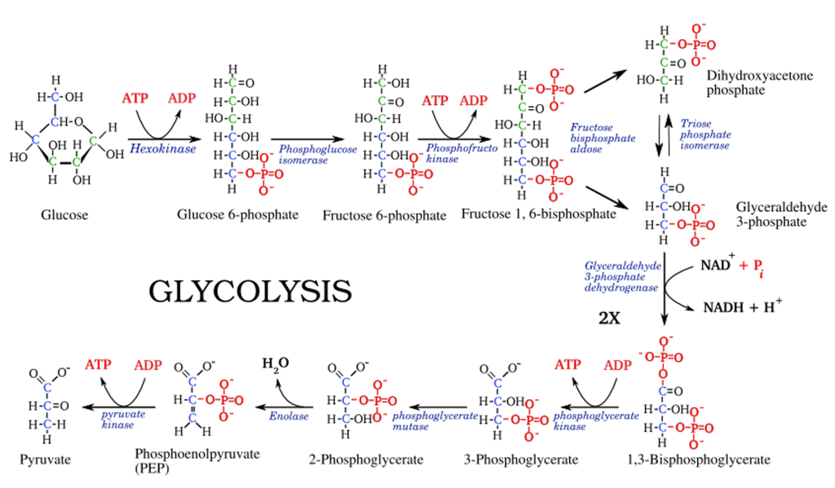
Glycolysis

Slide 22
Glycolysis stages
Stage 1
A phosphate group is added to glucose in the cell cytoplasm, by the action of enzyme hexokinase.
In this, a phosphate group is transferred from ATP to glucose forming glucose,6-phosphate.
Stage 2
Glucose-6-phosphate is isomerized into fructose,6-phosphate by the enzyme phosphoglucomutase.
Stage 3
The other ATP molecule transfers a phosphate group to fructose 6-phosphate and converts it into fructose 1,6-bisphosphate by the action of enzyme phosphofructokinase.

Slide 23
Glycolysis stages
Stage 4
The enzyme aldolase converts fructose 1,6-bisphosphate into glyceraldehyde 3-phosphate and dihydroxyacetone phosphate, which are isomers of each other.
Step 5
Triose-phosphate isomerase converts dihydroxyacetone phosphate into glyceraldehyde 3-phosphate which is the substrate in the successive step of glycolysis.
Step 6
This step undergoes two reactions:
-The enzyme glyceraldehyde 3-phosphate dehydrogenase transfers 1 hydrogen molecule from glyceraldehyde phosphate to nicotinamide adenine dinucleotide to form NADH + H⁺.
-Glyceraldehyde 3-phosphate dehydrogenase adds a phosphate to the oxidized glyceraldehyde phosphate to form 1,3-bisphosphoglycerate.

Slide 24
Glycolysis stages
Step 7
Phosphate is transferred from 1,3-bisphosphoglycerate to ADP to form ATP with the help of phosphoglycerokinase. Thus two molecules of phosphoglycerate and ATP are obtained at the end of this reaction.
Step 8
The phosphate of both the phosphoglycerate molecules is relocated from the third to the second carbon to yield two molecules of 2-phosphoglycerate by the enzyme phosphoglyceromutase.
Step 9
The enzyme enolase removes a water molecule from 2-phosphoglycerate to form phosphoenolpyruvate.
Step 10
A phosphate from phosphoenolpyruvate is transferred to ADP to form pyruvate and ATP by the action of pyruvate kinase. Two molecules of pyruvate and ATP are obtained as the end products.

Slide 25
Glycolysis stages
Key Points of Glycolysis
It is the process in which a glucose molecule is broken down into two molecules of pyruvate.
The process takes place in the cytoplasm of plant and animal cell.
Six enzymes are involved in the process.
The end products of the reaction include 2 pyruvate, 2 ATP and 2 NADH molecules.

Slide 26
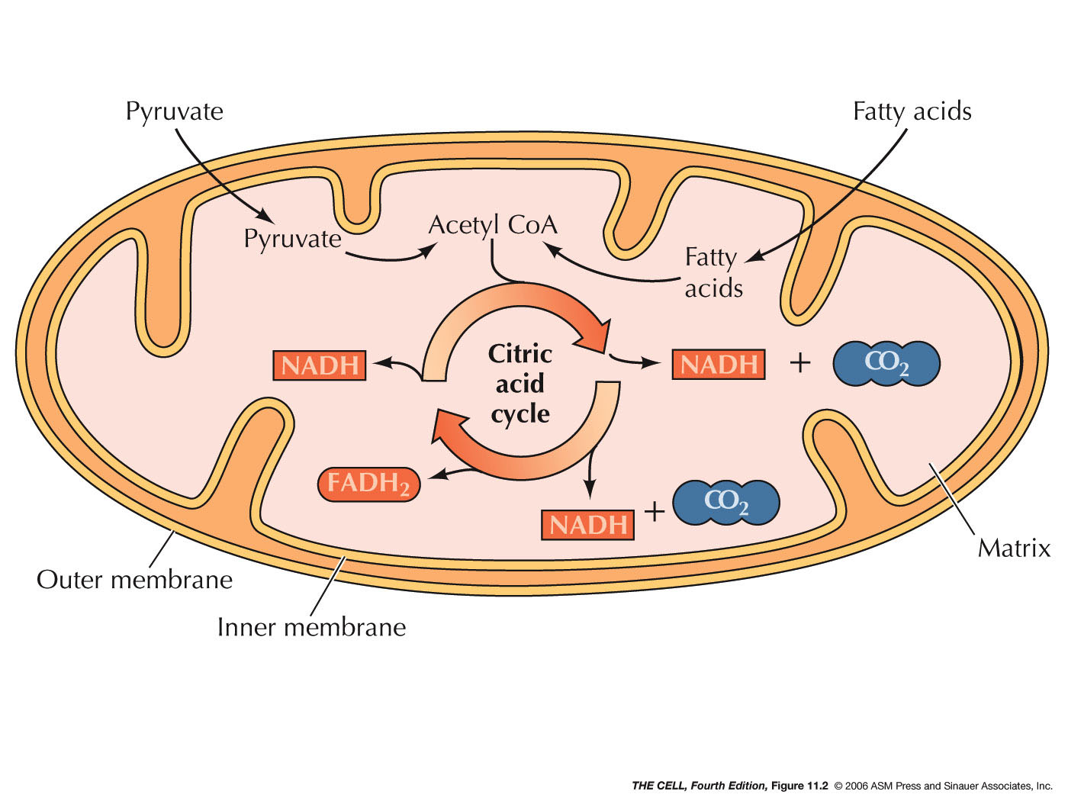
Kreb’s Cycle, TCA Cycle, Citric Acid Cycle

Slide 27
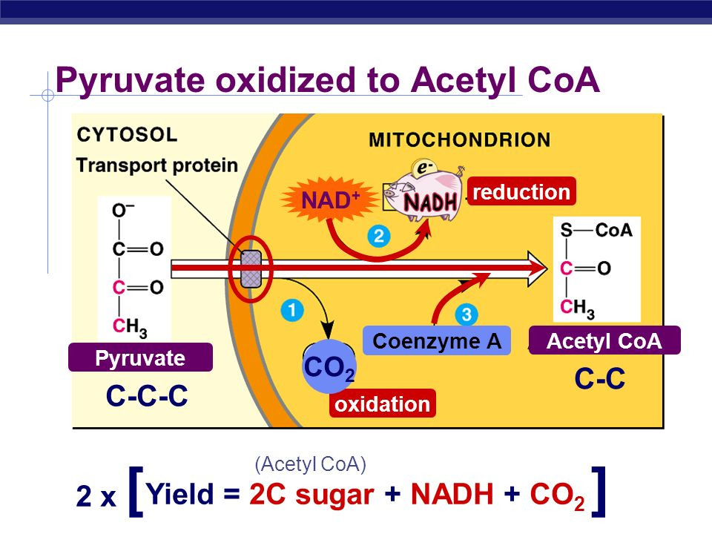

Slide 28
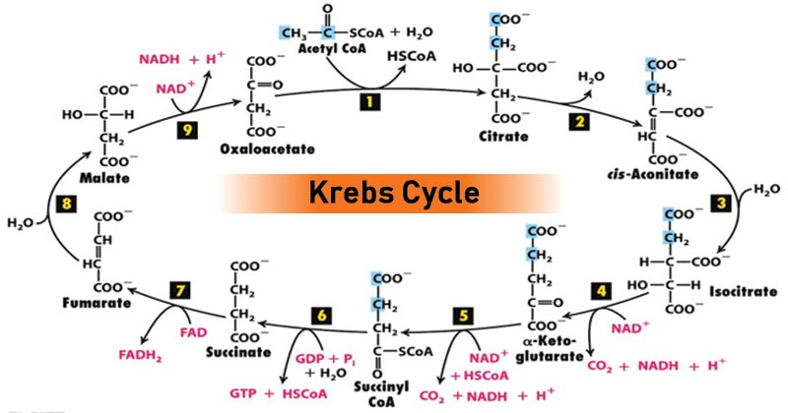
Kreb’s Cycle, TCA Cycle, Citric Acid Cycle

Slide 29
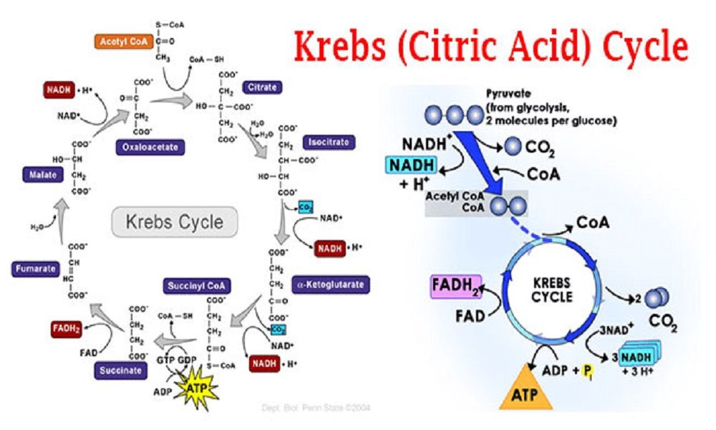

Slide 30
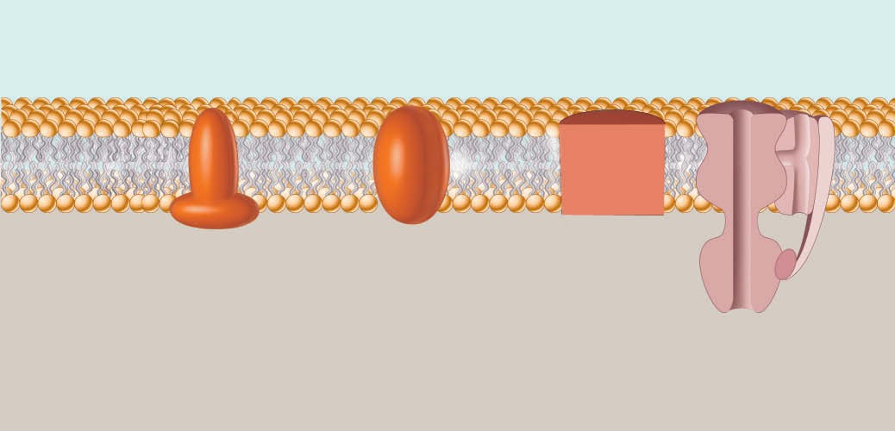
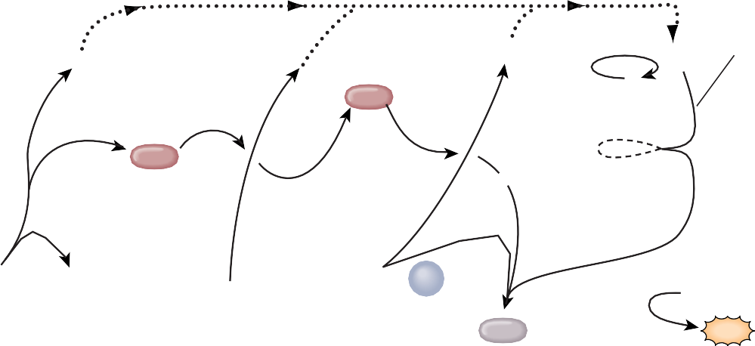




Space between outer and inner mitochondrial membranes
+
_{H}+
H channel
+
+
H
+
+ +
+
+
+
_{H}+
Cyt c
_{e}–
_{e}–
_{Q e}–
_{e}–
_{e}–
–
–
–
–
–
2H⁺ + ¹/₂ O₂
–
–
Mitochondrial matrix
3
NADH ^{+ H+} NAD⁺
_{H}+
ADP + P
H₂O
ATP synthase
ATP
1
2
Cytochrome b–c₁ complex: cyt b,–cyt c₁, and an Fe-S center
3
Cytochrome oxidase complex: cyt a, cyt a₃, and two Cu
NADH dehydrogenase complex: FMN and five Fe-S centers

Slide 31
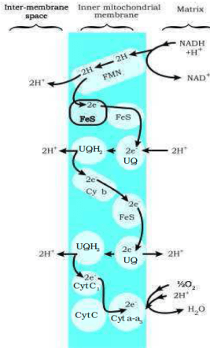

Slide 32
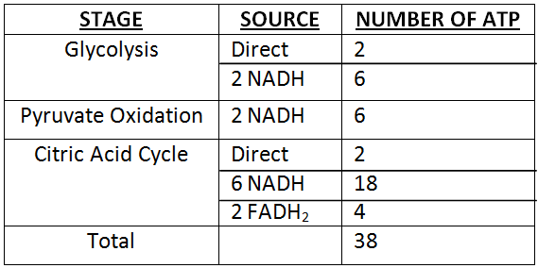
Balance sheet ATP

Slide 33
Glucose Anabolism
Glucose Storage: Glycogenesis:
If glucose is not needed immediately for ATP production, it com- bines with many other molecules of glucose to form glycogen, a polysaccharide that is the only stored form of carbohydrate in the body. The hormone insulin, from pancreatic beta cells, stimulates hepatocytes and skeletal muscle cells to carry out glycogenesis

Slide 34
Glucose Anabolism
The body can store about 500 g (about 1.1 lb) of glycogen, roughly 75% in skeletal muscle fibers and the rest in liver cells. During glycogenesis, glucose is first phosphorylated to glucose 6-phos- phate by hexokinase. Glucose 6-phosphate is converted to glu- cose 1-phosphate, then to uridine diphosphate glucose, and finally to glycogen.

Slide 35
Glucose Release: Glycogenolysis
Glucose Release: Glycogenolysis
When body activities require ATP, glycogen stored in hepato- cytes is broken down into glucose and released into the blood to be transported to cells, where it will be catabolized by the processes of cellular respiration already described. The pro- cess of splitting glycogen into its glucose subunits is called glycogenolysis

Slide 36
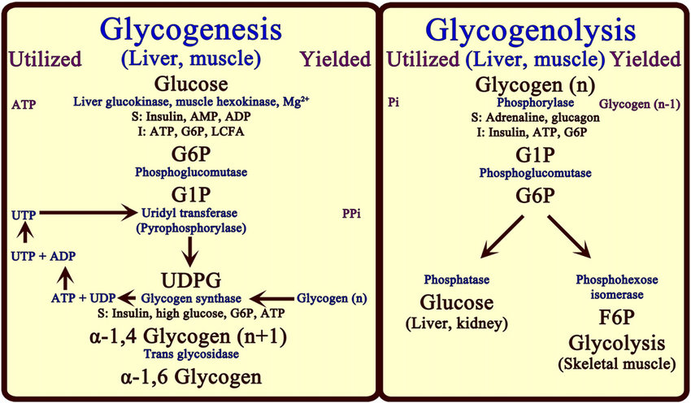

Slide 37
Gluconeogenesis
Formation of Glucose from Proteins and Fats: Gluconeogenesis
When your liver runs low on glycogen, it is time to eat. If you don’t, your body starts catabolizing triglycerides (fats) and pro- teins. Actually, the body normally catabolizes some of its triglyc- erides and proteins, but large-scale triglyceride and protein catabolism does not happen unless you are starving, eating very few carbohydrates, or suffering from an endocrine disorder. The glycerol part of triglycerides, lactic acid, and certain amino acids can be converted in the liver to glucose.The process by which glucose is formed from these non carbohydrate sources is called gluconeogenesis.

Slide 38
An easy way to distinguish this term from gly- cogenesis or glycogenolysis is to remember that in this case glucose is not converted back from glycogen, but is instead newly formed. About 60% of the amino acids in the body can be used for gluconeogenesis. Lactic acid and amino acids such as alanine, cysteine, glycine, serine, and threonine are converted to pyruvic acid, which then may be synthesized into glucose or enter the Krebs cycle. Glycerol may be converted into glyceraldehyde 3-phosphate, which may form pyruvic acid or be used to synthesize glucose.

Slide 39
Gluconeogenesis is stimulated by cortisol, the main glucocor- ticoid hormone of the adrenal cortex, and by glucagon from the pancreas. In addition, cortisol stimulates the breakdown of pro- teins into amino acids, thus expanding the pool of amino acids available for gluconeogenesis. Thyroid hormones (thyroxine and triiodothyronine) also mobilize proteins and may mobilize tri- glycerides from adipose tissue, thereby making glycerol available for gluconeogenesis.

Slide 40
